Slide 1
Practical#04
Designing state transition diagram

Slide 2
State transition diagram
It describes different states of a component in a system. The states are specific to a component/object of a system.
The system receives events from the outside world, and each event can cause the system to transit from one state to another.
As Statechart diagram defines states it is used to model lifetime of an object.

Slide 3
Purpose
The most important purpose of Statechart diagram is to model life time of an object from creation to termination.
To model dynamic aspect of a system.
To model life time of a reactive system.
To describe different states of an object during its life time.
Define a state machine to model states of an object.

Slide 4
State Transition Diagram:
State diagrams are used:
to describe the behavior of a system.
* Specifically a state diagram describes the behavior of a single object in response to a series of events in a system.

Slide 5
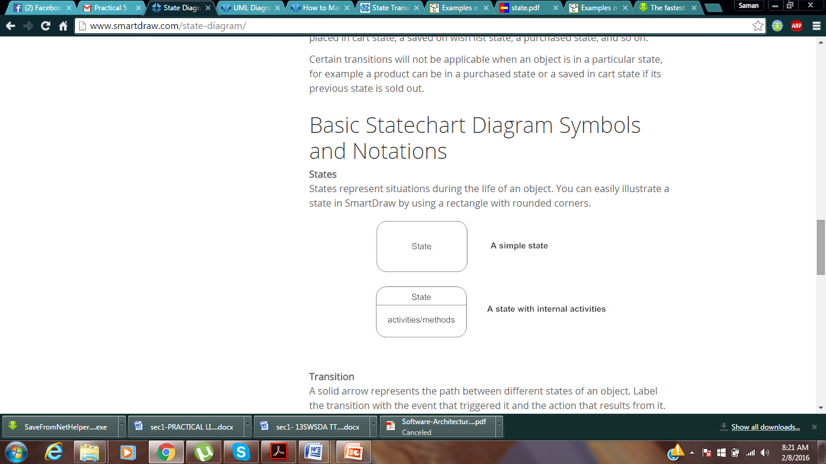
Basic State Diagram Symbols and Notations
States:
States represent situations during the life of an object.

Slide 6
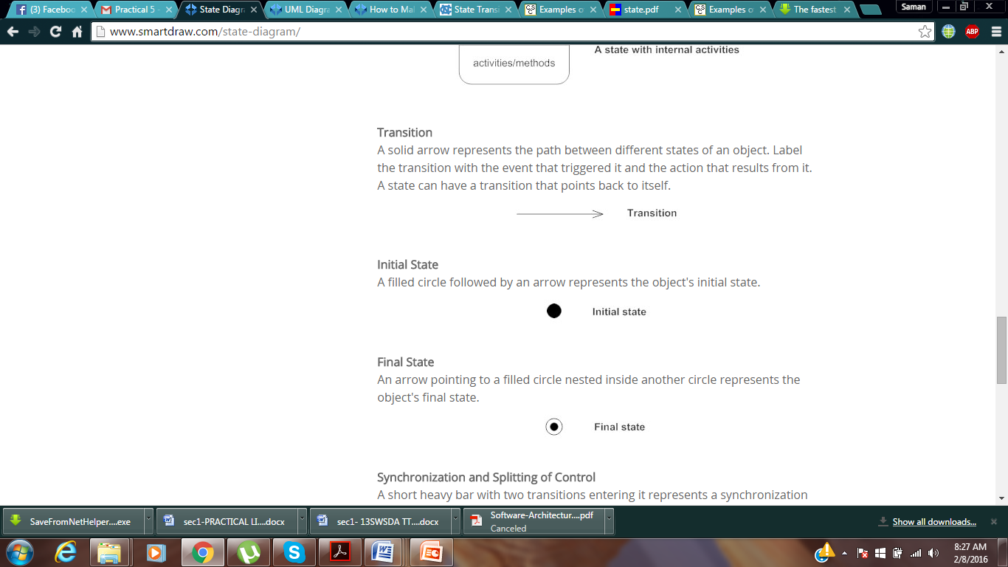
2. Transitions:
A solid arrow represents the path between different states of an object.
Label the transition with the event that triggered it and the action that results from it.

Slide 7
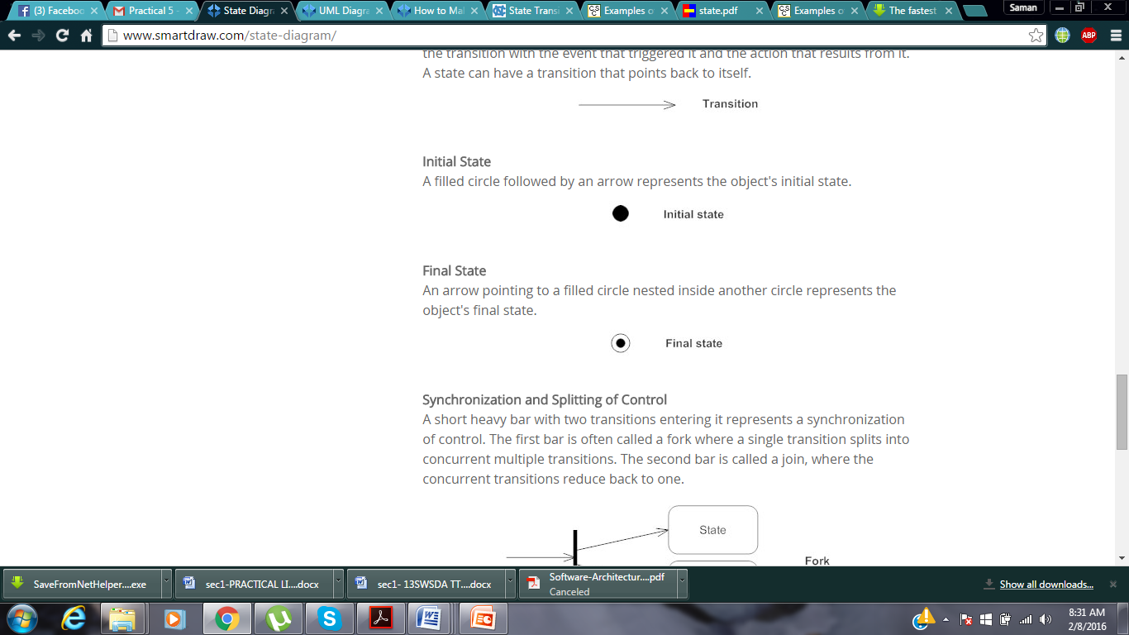
3. Initial state:
A filled circle followed by an arrow represents the object's initial state.

Slide 8

4. Final state:
An arrow pointing to a filled circle nested inside another circle represents the object's final state.

Slide 9
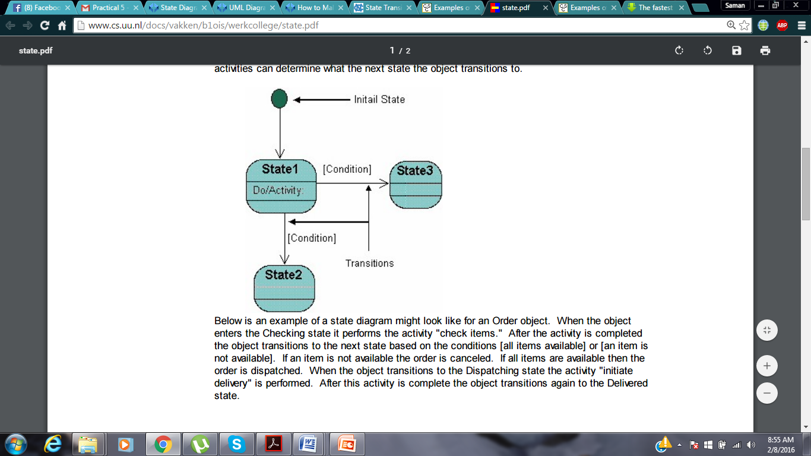
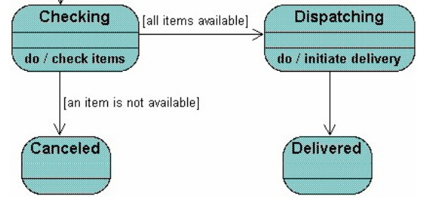
Example 1:

Slide 10
The following is an example of a Statechart diagram where the state of an object is analyzed.

Slide 11
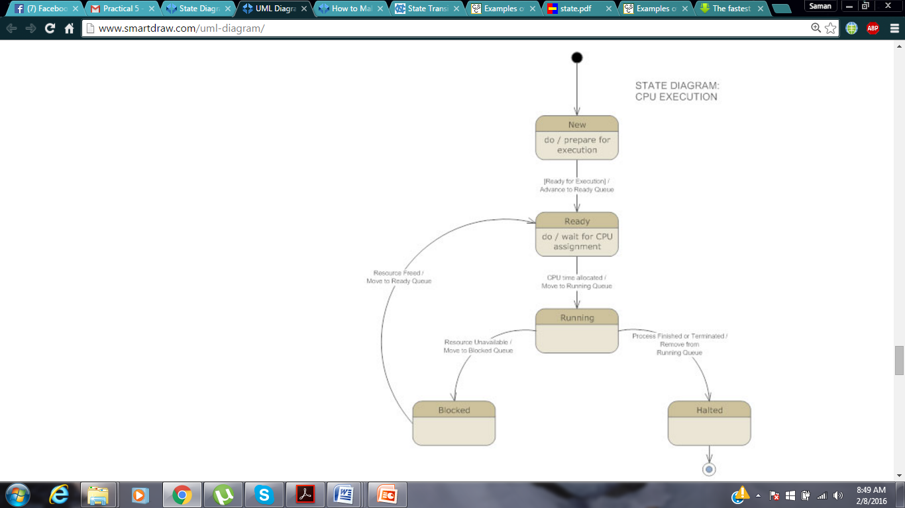

Slide 12
TASK:
Create a state Transition diagram of:
Flight reservation
ATM process
Softwares:
Rational rose
Star UML
Smart Draw
Or any other

